Slide 2
InnerHTML vs InnerText

Slide 3
<html> <body>
<h2>innerhtml << textformat </h2>
<pre id=txtin_html></pre>
<h2>innerhtml << htmlformat </h2>
<pre id=htmlin_html></pre>
<h2>innerText << txtformat </h2>
<pre id=txtin_txt></pre>
<h2>innerText << htmlformat </h2>
<pre id=htmlin_txt></pre>
<script type="text/javascript">
var commenthtml = '<ul><li style="color:red;">This is a comment</ul>';
var commenttext = '&lt;ul&gt;&lt;li style=&quot;color:red;&quot;&gt;This is a comment&lt;/ul&gt;';
var span1=document.createElement("span"); span1.innerHTML=commenttext;
console.log( 'span1.textContent: ' + span1.textContent );
console.log( 'span1.innerHTML:' + span1.innerHTML ); document.getElementById('txtin_html').innerHTML = commenttext;
document.getElementById('htmlin_html').innerHTML = commenthtml;
document.getElementById('txtin_txt').innerText = commenttext;
document.getElementById('htmlin_txt').innerText = commenthtml;
//文字進innerHTML，再分別利用innerHTML,innerText讀出
console.log(document.getElementById('txtin_html').innerHTML);
console.log(document.getElementById('txtin_html').innerText);
//標籤進innerHTML，再分別利用innerHTML,innerText讀出
console.log(document.getElementById('htmlin_html').innerHTML);
console.log(document.getElementById('htmlin_html').innerText);
//文字進innerText，再分別利用innerHTML,innerText讀出
console.log(document.getElementById('txtin_txt').innerHTML);
console.log(document.getElementById('txtin_txt').innerText);
//標籤進innerText，再分別利用innerHTML,innerText讀出
console.log(document.getElementById('htmlin_txt').innerHTML);
console.log(document.getElementById('htmlin_txt').innerText);
</script> </body> </html>

Slide 4
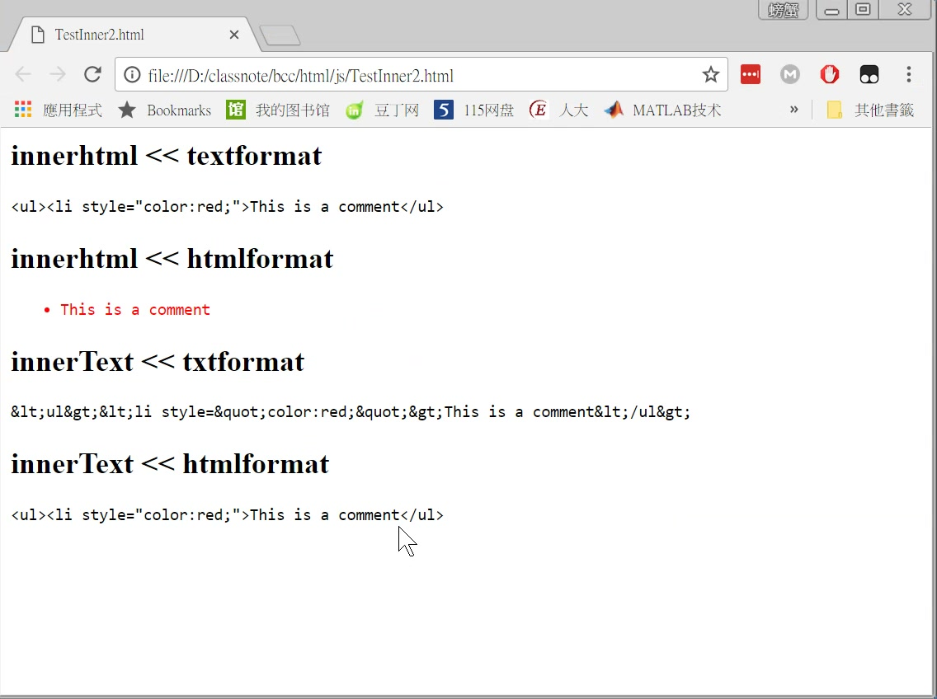
document.getElementById('txtin_html').innerHTML = commenttext; document.getElementById('htmlin_html').innerHTML = commenthtml; document.getElementById('txtin_txt').innerText = commenttext; document.getElementById('htmlin_txt').innerText = commenthtml;

Slide 5
解讀html tag
document.getElementById('txtin_html').innerHTML = commenttext; document.getElementById('htmlin_html').innerHTML = commenthtml; document.getElementById('txtin_txt').innerText = commenttext; document.getElementById('htmlin_txt').innerText = commenthtml;

Slide 6
var commenttext = '&lt;ul&gt;&lt;li style=&quot;color:red;&quot;&gt;This is a comment&lt;/ul&gt;';
var commenthtml = '<ul><li style="color:red;">This is a comment</ul>';
雖然不解讀tag但是解讀&(x);
原來是怎樣,還是怎麼樣

Slide 7
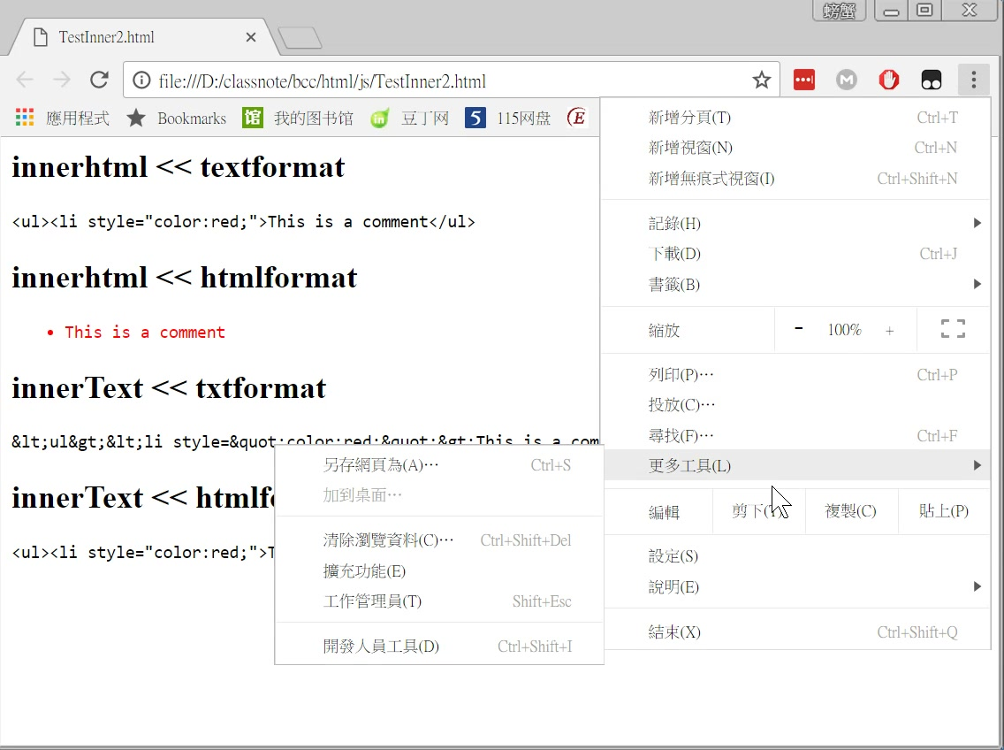

Slide 8
紅綠都放入innerHTML

Slide 9
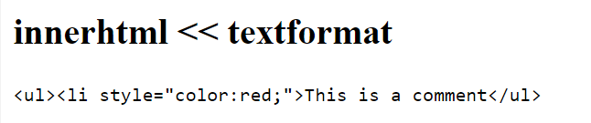
'&lt;ul&gt;&lt;li style=&quot;color:red;&quot;&gt;This is a comment&lt;/ul&gt;';
紅字丟進innerHTML,再利用innerHTML,innerText讀出
innerHTML:
&lt;ul&gt;&lt;li style="color:red;"&gt;This is a comment&lt;/ul&gt;
innerText:
<ul><li style="color:red;">This is a comment</ul>
互為翻譯

Slide 10
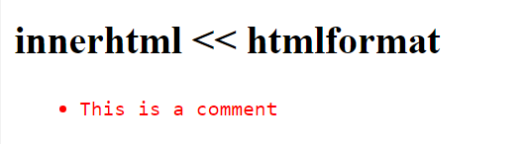

'<ul><li style="color:red;">This is a comment</ul>';
綠字丟進innerHTML,再利用innerHTML,innerText讀出
innerHTML:
<ul><li style="color:red;">This is a comment</li></ul>
innerText:
This is a comment

Slide 11
紅綠都放入innerText

Slide 12
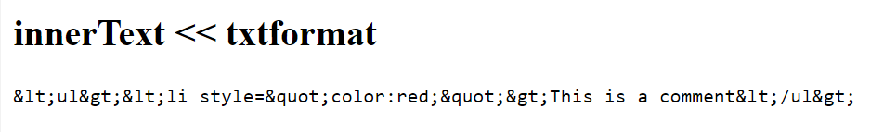
'&lt;ul&gt;&lt;li style=&quot;color:red;&quot;&gt;This is a comment&lt;/ul&gt;';
放入innerText，都忠實呈現
紅字丟進innerText,再利用innerHTML,innerText讀出
innerHTML:
&amp;lt;ul&amp;gt;&amp;lt;li style=&amp;quot;color:red;&amp;quot;&amp;gt;This is a comment&amp;lt;/ul&amp;gt;
innerText:
&lt;ul&gt;&lt;li style=&quot;color:red;&quot;&gt;This is a comment&lt;/ul&gt;

Slide 13
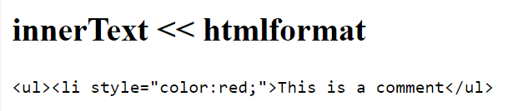
'<ul><li style="color:red;">This is a comment</ul>';
放入innerText，都忠實呈現
綠字丟進innerText,再利用innerHTML,innerText讀出
innerHTML:
&lt;ul&gt;&lt;li style="color:red;"&gt;This is a comment&lt;/ul&gt;
innerText:
<ul><li style="color:red;">This is a comment</ul>
因為利用文字函數設定，所以為了避免被html解讀，自動將標籤轉為符號。

Slide 14
問題：
var x="this is a book'
obj.innerText=x;
則
obj.innerHTML=?
預測是 this is a book

